Slide 1
EBN 111/122 ELECTRICITY AND ELECTRONICS
Chapter 3
Methods of Analysis

Slide 2
Methods of Analysis - Chapter 3
3.1 Motivation
3.2 Nodal analysis.
3.3 Nodal analysis with voltage sources.
3.4 Mesh analysis.
3.5 Mesh analysis with current sources.
3.6 Nodal and mesh analysis by inspection.
3.7 Nodal versus mesh analysis.

Slide 3
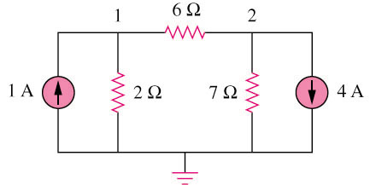
3.1 Motivation (1)
If you are given the following circuit, how can we determine (1) the voltage across each resistor, (2) current through each resistor. (3) power generated by each current source, etc.
What are the things which we need to know in order to determine the answers?

Slide 4
Things we need to know in solving any resistive circuit with current and voltage sources only:
3.1 Motivation (2)
The LAWS
Kirchhoff’s Current Laws (KCL)
Kirchhoff’s Voltage Laws (KVL)
Ohm’s Law
How should we apply these laws to determine the answers?

Slide 5
3.1 Motivation (3)
THESE TWO TECHNIQUES
KCL ⟶ Nodal Analysis
aka (Voltage Node Analysis)
KVL ⟶ Mesh (Current) Analysis
Can be used in any linear circuit
To obtain a set of simultaneous equations
Equations solved using:
Substitution
Cramer’s rule (Appendix A)

Slide 6
3.2 Nodal Analysis Why?
It provides a general procedure for analyzing circuits using node voltages as opposed to element voltages as the circuit variables.
Reduces the number of equations required to solve a circuit.

Slide 7
3.2 Nodal Analysis STEPS
Steps to determine the node voltages:
Select a node as the reference node (ground).
Assign voltages V₁,V₂,…,V_{n-1} to the remaining “critical” nodes.
“Critical node” = node with more than 2 branches attached.
The voltages are referenced with respect to the reference node. I.e. Measured between Node and Ground.
Apply KCL to each of the non-reference nodes. Use Ohm’s law to express the branch currents in terms of node voltages.
Solve the resulting simultaneous equations to obtain the unknown node voltages.

Slide 8
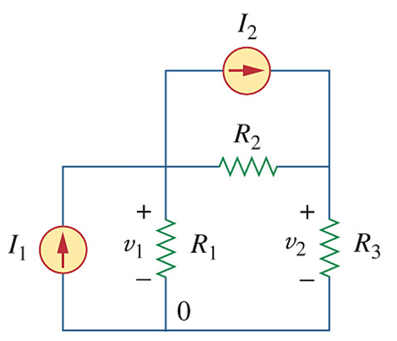
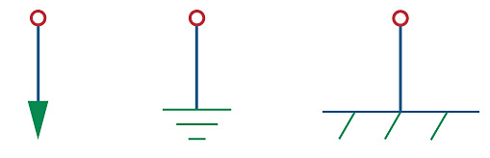

3.2 Nodal Analysis
EXAMPLE 1
STEP 1: Select a Reference Node
WHERE??
Negative terminal of V-source
Entry terminal of I-source
Node with many branches
Bottom node (many cases)
STEP 2
V₁
V₂
STEP 1
STEP 2: Name critical nodes: V₁, V₂, …, V_{n}

Slide 9
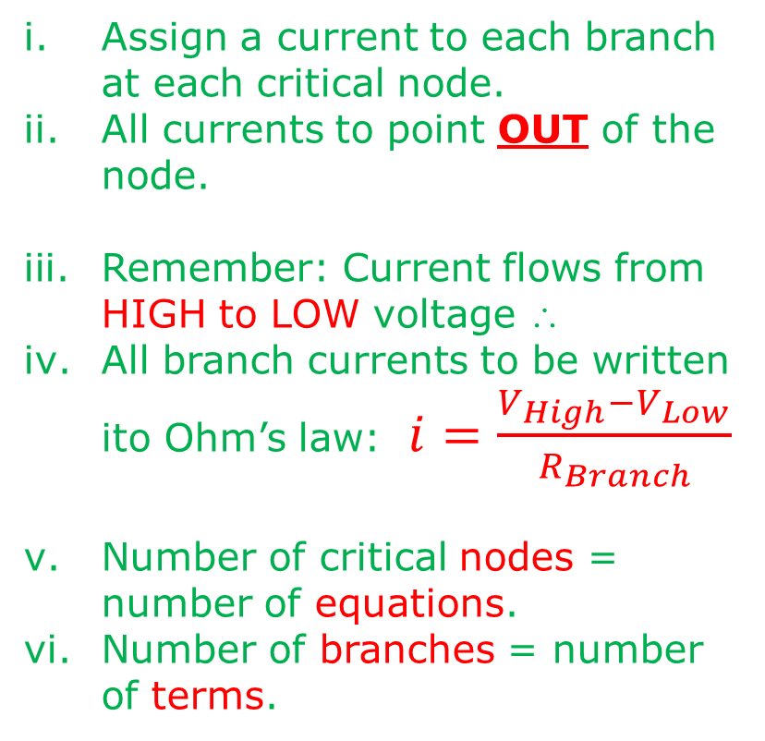
3.2 Nodal Analysis
EXAMPLE 1
STEP 3: Apply KCL to each node
Assign a current to each branch at each critical node.
All currents to point OUT of the node.
Remember: Current flows from HIGH to LOW voltage ∴
All branch currents to be written ito Ohm’s law: $i=\frac{V_{High}−V_{Low}}{R_{Branch}}$
Number of critical nodes = number of equations.
Number of branches = number of terms.
V₁
V₂

Slide 10
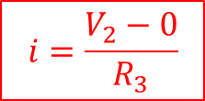
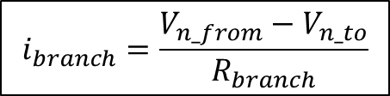

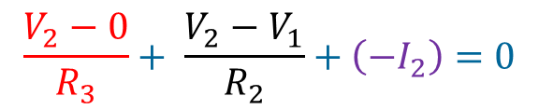
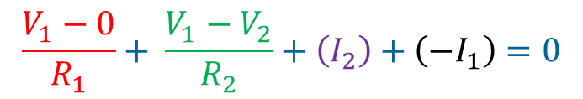
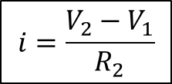
3.2 Nodal Analysis
EXAMPLE 1
STEP 3: Apply KCL to each node
$$i=\frac{V_{High}−V_{Low}}{R_{Branch}}$$
$$i_{branch}=\frac{V_{n_from}−V_{n_to}}{R_{branch}}$$
V₁
V₂
Flows from? V₂
Flows to? Gnd
Flows through? R₃
V₂
V₁
R₂
$$i=\frac{V_{2}−0}{R_{3}}$$
$$i=\frac{V_{2}−V_{1}}{R_{2}}$$
$$\frac{V_{2}−0}{R_{3}}+ \frac{V_{2}−V_{1}}{R_{2}}+\left({−I}_{2}\right)=0$$
Node 2 (3 Branches):
Negative because outgoing branch current is opposite to the source’s current
$$\frac{V_{1}−0}{R_{1}}+ \frac{V_{1}−V_{2}}{R_{2}}+\left(I_{2}\right)+\left({−I}_{1}\right)=0$$
Node 1 (4 Branches):

Slide 11
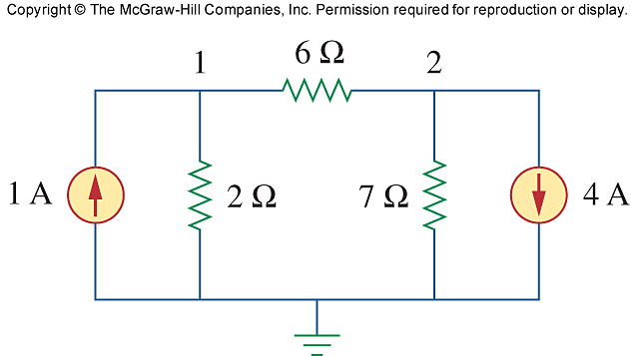

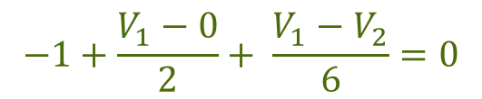
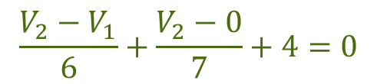







3.2 Nodal Analysis
EXAMPLE 2
V₁
V₂
$$−1+\frac{V_{1}−0}{2}+ \frac{V_{1}−V_{2}}{6}=0$$
Node 1:
x6
$$−6+{3V}_{1}+V_{1}−V_{2}=0$$
Write ito:
$${a1V}_{1}+{b1V}_{2}=k_{1}$$
$${4V}_{1}+{(−1)V}_{2}=6$$
1
$${4V}_{1}+{(−1)V}_{2} =6$$
1
$$\frac{V_{2}−V_{1}}{6}+\frac{V_{2}−0}{7}+4=0$$
$${(−7)V}_{1} +{ 13V}_{2} =−168$$
Node 2:
2
x42
$${7V}_{2}−{7V}_{1}+{6V}_{2}+168=0$$
a₁ = 4
b₁ = -1
a₂ = -7
b₂ = 13
Write ito:
$${a2V}_{1}+{b2V}_{2}=k_{2}$$
$${(−7)V}_{1}+{13V}_{2}=−168$$
2

Slide 12









3.2 Nodal Analysis
Ex. 2 – Method 1: Elimination
V₁
V₂
$${4V}_{1}+{(−1)V}_{2} =6$$
1
$${(−7)V}_{1} +{ 13V}_{2} =−168$$
2
1
$$V_{2} ={4V}_{1}−6$$
From :
3
3
in :
$${(−7)V}_{1} +13\left({4V}_{1}−6 \right) =−168$$
2
$${45V}_{1} −78 =−168$$
$$45V_{1} =−90$$
$$V_{1} =−2 V$$
3
$$V_{2} =4(−2)−6$$
From :
$$V_{2} =−14 V$$

Slide 13
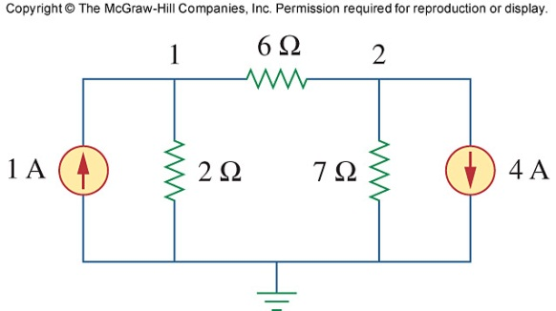


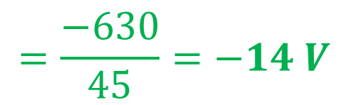

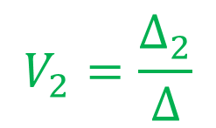

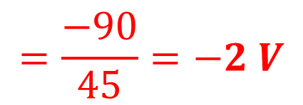

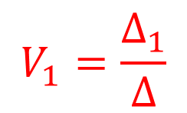
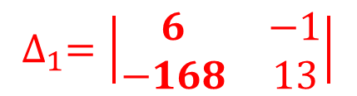
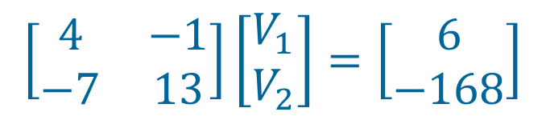




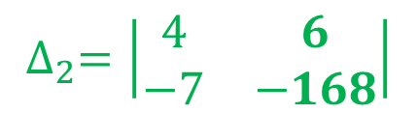
3.2 Nodal Analysis
Ex. 2 – Method 2: Cramer’s Rule
See Appendix A
$$∆=\left|\begin{matrix}4 & −1 \\ −7 & 13\end{matrix}\right|$$
$$∆=\left(4×13\right)−(−1×−7)$$
$${4V}_{1}+{(−1)V}_{2} =6$$
1
$$∆=45$$
$${(−7)V}_{1} +{ 13V}_{2} =−168$$
2
$$∆_{1}=\left|\begin{matrix}6 & −1 \\ −168 & 13\end{matrix}\right|$$
$$\left[\begin{matrix}4 & −1 \\ −7 & 13\end{matrix}\right]\left[\begin{matrix}V_{1} \\ V_{2}\end{matrix}\right]=\left[\begin{matrix}6 \\ −168\end{matrix}\right]$$
$$∆_{1}=\left(6×13\right)−(−1×−168)$$
$$∆_{1}=−90$$
$$V_{1}=\frac{∆_{1}}{∆}$$
$$=\frac{−90}{45}=−2 V$$
$$∆_{2}=\left|\begin{matrix}4 & 6 \\ −7 & −168\end{matrix}\right|$$
$$V_{2}=\frac{∆_{2}}{∆}$$
$$=\frac{−630}{45}=−14 V$$
$$∆_{2}=\left(4×−168\right)−(6×−7)$$
$$∆_{2}=−630$$

Slide 14
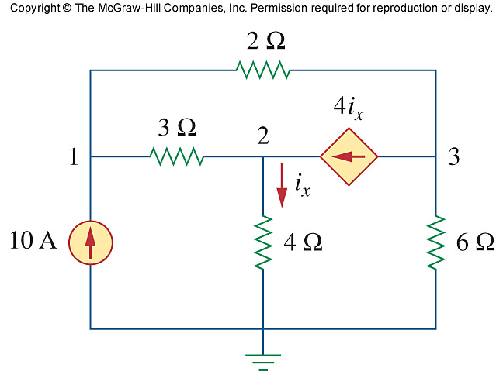

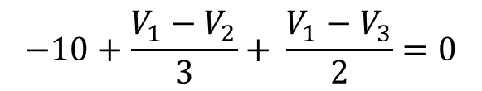
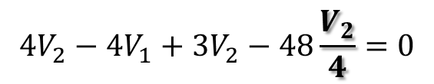
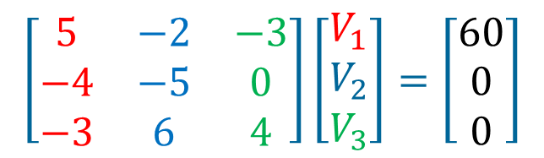
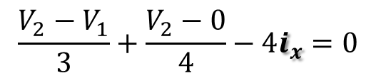


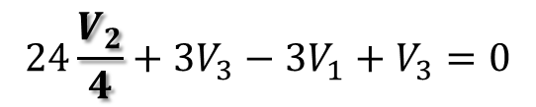

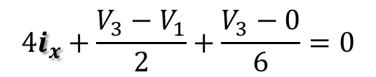
PP 3-2 Determine the node voltages.
Node 1:
$$−10+\frac{V_{1}−V_{2}}{3}+ \frac{V_{1}−V_{3}}{2}=0$$
V₁
V₂
V₃
x6
$$−60+{2V}_{1}−2V_{2}+{3V}_{1}−{3V}_{3}=0$$
$$5V_{1}−2V_{2}−3V_{3}=60$$
1
Node 2:
$$\frac{V_{2}−V_{1}}{3}+\frac{V_{2}−0}{4}−4i_{x}=0$$
$${4V}_{2}−4V_{1}+{3V}_{2}−48\frac{V_{2}}{4}=0$$
x12
$$\left[\begin{matrix}5 & −2 & −3 \\ −4 & −5 & 0 \\ −3 & 6 & 4\end{matrix}\right]\left[\begin{matrix}V_{1} \\ V_{2} \\ V_{3}\end{matrix}\right]=\left[\begin{matrix}60 \\ 0 \\ 0\end{matrix}\right]$$
$$−4V_{1}−5V_{2}+0V_{3}=0$$
2
Node 3:
$$4i_{x}+\frac{V_{3}−V_{1}}{2}+\frac{V_{3}−0}{6}=0$$
$$24\frac{V_{2}}{4}+3V_{3}−{3V}_{1}+V_{3}=0$$
x6
$$−3V_{1}+6V_{2}+4V_{3}=0$$
3

Slide 15
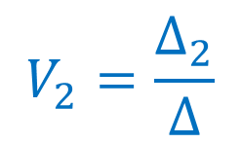
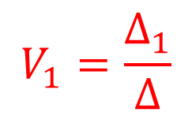

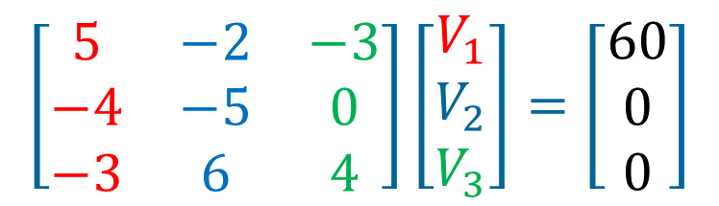
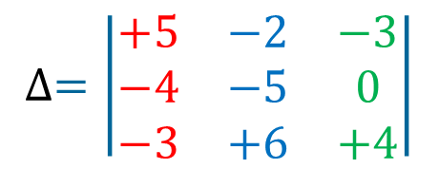

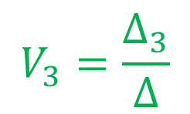
PP 3-2 continued: Calculating Δ
$$\left[\begin{matrix}5 & −2 & −3 \\ −4 & −5 & 0 \\ −3 & 6 & 4\end{matrix}\right]\left[\begin{matrix}V_{1} \\ V_{2} \\ V_{3}\end{matrix}\right]=\left[\begin{matrix}60 \\ 0 \\ 0\end{matrix}\right]$$
$$V_{1}=\frac{∆_{1}}{∆}$$
$$∆=\left|\begin{matrix}+5 & −2 & −3 \\ −4 & −5 & 0 \\ −3 & +6 & +4\end{matrix}\right|$$
$$V_{2}=\frac{∆_{2}}{∆}$$
-
+
$$\begin{matrix}+5 & −2 & −3 \\ −4 & −5 & 0\end{matrix}$$
-
+
-
+
$$V_{3}=\frac{∆_{3}}{∆}$$
$$∆ =\left(5∙−5∙4\right)+\left(−4∙6∙−3\right)+\left(−3∙−2∙0\right)$$
$$−\left(−3∙−5∙−3\right)−\left(0∙6∙5\right)−\left(4∙−2∙−4\right)$$
$$=−100+72+0−\left(−45\right)−0−32$$
$$=−15$$

Slide 16

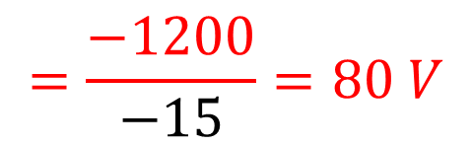



PP 3-2 continued: Calculating Δ₁
$$\left[\begin{matrix}5 & −2 & −3 \\ −4 & −5 & 0 \\ −3 & 6 & 4\end{matrix}\right]\left[\begin{matrix}V_{1} \\ V_{2} \\ V_{3}\end{matrix}\right]=\left[\begin{matrix}60 \\ 0 \\ 0\end{matrix}\right]$$
$$V_{1}=\frac{∆_{1}}{∆}$$
$$=\frac{−1200}{−15}=80 V$$
$$∆_{1}=\left|\begin{matrix}60 & −2 & −3 \\ 0 & −5 & +0 \\ 0 & +6 & +4\end{matrix}\right|$$
$$V_{2}=\frac{∆_{2}}{∆}$$
-
+
$$\begin{matrix}60 & −2 & −3 \\ 0 & −5 & +0\end{matrix}$$
-
+
-
+
$$V_{3}=\frac{∆_{3}}{∆}$$
$$∆_{1} =\left(60∙−5∙4\right)+\left(0∙6∙−3\right)+\left(0∙−2∙0\right)$$
$$−\left(−3∙−5∙0\right)−\left(0∙6∙60\right)−\left(4∙−2∙0\right)$$
$$=−1200+0+0−0−0−0$$
$$=−1200$$

Slide 17
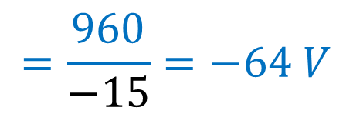


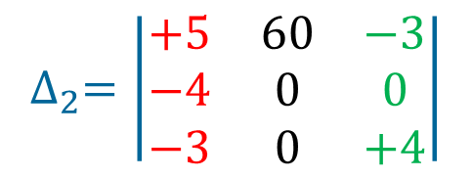


PP 3-2 continued: Calculating Δ₂
$$\left[\begin{matrix}5 & −2 & −3 \\ −4 & −5 & 0 \\ −3 & 6 & 4\end{matrix}\right]\left[\begin{matrix}V_{1} \\ V_{2} \\ V_{3}\end{matrix}\right]=\left[\begin{matrix}60 \\ 0 \\ 0\end{matrix}\right]$$
$$V_{1}=\frac{∆_{1}}{∆}$$
$$∆_{2}=\left|\begin{matrix}+5 & 60 & −3 \\ −4 & 0 & 0 \\ −3 & 0 & +4\end{matrix}\right|$$
$$=80 V$$
$$V_{2}=\frac{∆_{2}}{∆}$$
$$=\frac{960}{−15}=−64 V$$
-
+
$$\begin{matrix}+5 & 60 & −3 \\ −4 & 0 & +0\end{matrix}$$
-
+
-
+
$$V_{3}=\frac{∆_{3}}{∆}$$
$$∆_{2} =\left(5∙0∙4\right)+\left(−4∙0∙−3\right)+\left(−3∙60∙0\right)$$
$$−\left(−3∙0∙−3\right)−\left(0∙0∙5\right)−\left(4∙60∙−4\right)$$
$$=0+0+0−0−0−(−960)$$
$$=960$$

Slide 18



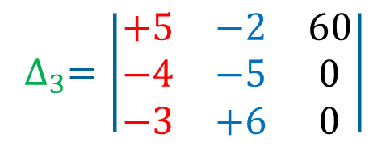


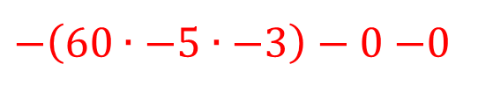
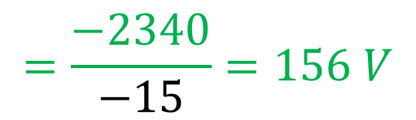
PP 3-2 continued: Calculating Δ₃
$$\left[\begin{matrix}5 & −2 & −3 \\ −4 & −5 & 0 \\ −3 & 6 & 4\end{matrix}\right]\left[\begin{matrix}V_{1} \\ V_{2} \\ V_{3}\end{matrix}\right]=\left[\begin{matrix}60 \\ 0 \\ 0\end{matrix}\right]$$
$$V_{1}=\frac{∆_{1}}{∆}$$
$$∆_{3}=\left|\begin{matrix}+5 & −2 & 60 \\ −4 & −5 & 0 \\ −3 & +6 & 0\end{matrix}\right|$$
$$=80 V$$
$$V_{2}=\frac{∆_{2}}{∆}$$
-
+
$$=−64 V$$
$$\begin{matrix}+5 & −2 & 60 \\ −4 & −5 & 0\end{matrix}$$
-
+
-
+
$$V_{3}=\frac{∆_{3}}{∆}$$
$$=\frac{−2340}{−15}=156 V$$
$$∆_{3} =0+\left(−4∙6∙603\right)+0$$
$−\left(60∙−5∙−3\right)−0−$0
$$=−1440−900$$
$$=−2340$$

Slide 19
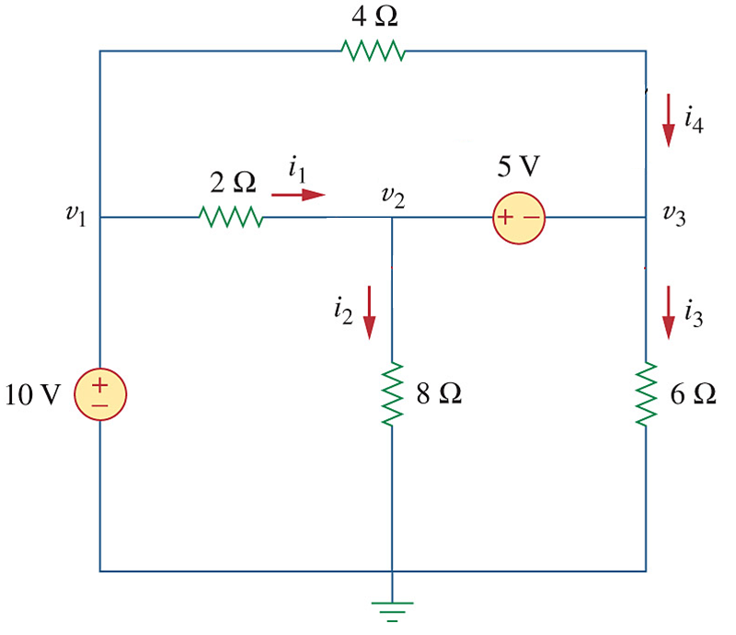
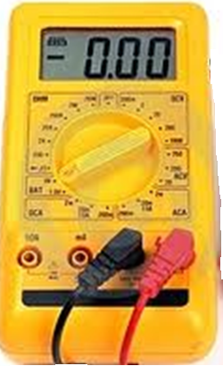
Ch. 3 L#2: 3.3 Nodal Analysis With Voltage sources
Case 1: V_{s} between a node and GND:
V₁ – 0 = 10 V
5.00
V₁
V₃
V₂
10.00
Case 2: V_{s} between two nodes:
V₂ – V₃ = 5 V
SUPERNODE

Slide 20




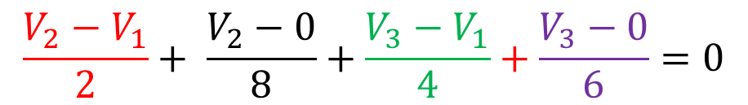

3.3 Nodal Analysis With Voltage sources
SUPERNODE
Formed by enclosing a (dependent or independent) voltage source connected between two non-reference nodes along with any elements connected in parallel with that voltage source.
V₁
V₃
V₂
$$V_{1}=10$$
1
$$V_{2}−V_{3}=5$$
2
$$10$$
$$10$$
$$\frac{V_{2}−V_{1}}{2}+ \frac{V_{2}−0}{8}+\frac{V_{3}−V_{1}}{4}+\frac{V_{3}−0}{6}=0$$
$$KCL at SUPERNODE:$$
3
Solve for V₂ and V₃ from and
2
3

Slide 21
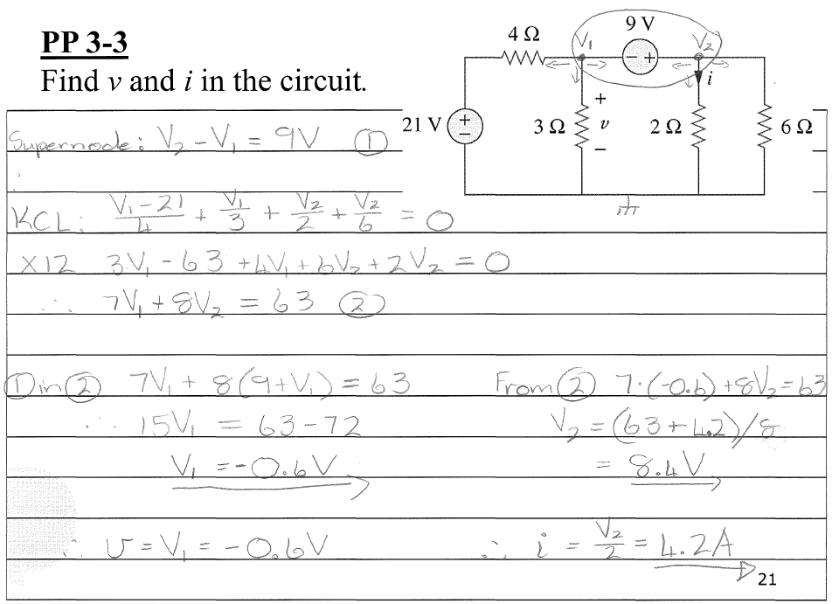
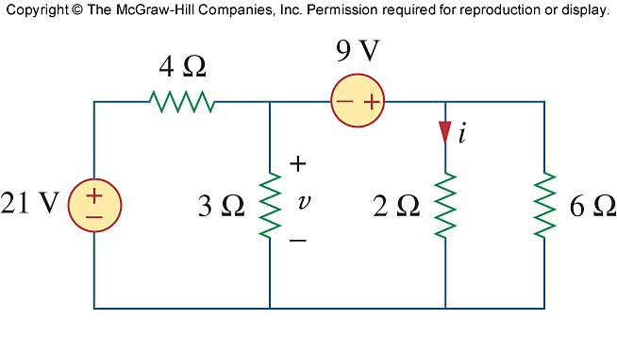
PP 3-3 Find v and i in the circuit.

Slide 22

PP 3-3 Continued…
PP 3-3 Find v and i in the circuit.

Slide 23


PP 3-4 Find v₁, v₂, v₃ and i.

Slide 24

PP 3-4 Continued…

Slide 25


Problem 3-16 Find v₁, v₂ and v₃.

Slide 26


Problem 3-4 Find I₁ through I₄.
V₁
V₂

Slide 27
Ch. 3 L#3: 3.4 Mesh Analysis Why?
Mesh analysis provides another general procedure for analyzing circuits using mesh currents as the circuit variables.
Nodal analysis applies KCL to find unknown voltages in a given circuit, while mesh analysis applies KVL to find unknown currents.
A mesh is a loop which does not contain any other loops within it.

Slide 28

3.4 Mesh Analysis STEPS
I₁ = i₁
I₂ = i₂
I₃ = i₁ – i₂
Steps to determine the mesh currents:
Assign mesh currents i₁, i₂, …, in to the n meshes – clock wise.
Apply KVL to each of the n meshes. Use Ohm’s law to express the voltages in terms of the mesh currents.
Solve the resulting n simultaneous equations to get the mesh currents.

Slide 29
3.4 Mesh Analysis STEPS: KVL in Loops
R₃ has 2 currents flowing through it: i₁ and i₂
i₂ causes a voltage drop from bottom to top: i₂R₃
i₁ causes a voltage drop from top to bottom: i₁R₃
+ i₁R₁ –
+ i₂R₂ –
+
i₁R₃
–
–
i₂R₃
+
Loop 1:
– V₁ + R₁i₁ + R₃(i₁ – i₂) = 0
Write ito:
a₁i₁ + b₁i₂ = k₁
I_{net} through R₃ wrt loop 1
R(i_{loop} – i_{opposing_loop})
(R₁+ R₃)i₁ + (–R₃) i₂ = V₁
Loop 2:
V₂ + R₃(i₂ – i₁) + i₂R₂ = 0
a₂i₁ + b₂i₂ = k₂
I_{net} through R₃ wrt loop 2
Write ito:
(–R₃)i₁ + (R₂ + R₃) i₂ = – V₂

Slide 30







PP 3-5
Determine i₁ and i₂.
i₁
i₂
Loop 1:
– 36 + 2i₁ + 12(i₁ – i₂) + 4i₁ = 0
$∆=\left|\begin{matrix}18 & −12 \\ −12 & 24\end{matrix}\right|$ = 288
(2+12+4)i₁ + (–12)i₂ = 36
$$∆_{1}=\left|\begin{matrix}36 & −12 \\ −24 & 24\end{matrix}\right|=576$$
(18)i₁ + (–12)i₂ = 36
1
24 + 3i₂ + 12(i₂ – i₁) + 9i₂ = 0
$$∆_{2}=\left|\begin{matrix}18 & 36 \\ −12 & −24\end{matrix}\right|=0$$
Loop 2:
(–12)i₁ + (3+12+9)i₂ = –24
$$i1=\frac{∆1}{∆}=\frac{576}{288}=2 A$$
(–12)i₁ + (24)i₂ = –24
2
$$i2=\frac{∆2}{∆}=\frac{0}{288}=0 A$$
$$\left[\begin{matrix}18 & −12 \\ −12 & 24\end{matrix}\right]\left[\begin{matrix}i_{1} \\ i_{2}\end{matrix}\right]=\left[\begin{matrix}36 \\ −24\end{matrix}\right]$$
Matrix:

Slide 31


PP 3-6 Determine I_{o}.
Note:
I_{o} = i₃
CCVS: 10i_{o} = 10i₃
i₃
$$\left[\begin{matrix}6 & −2 & −4 \\ −2 & 10 & −18 \\ −4 & −8 & 18\end{matrix}\right]\left[\begin{matrix}i_{1} \\ i_{2} \\ i_{3}\end{matrix}\right]=\left[\begin{matrix}20 \\ 0 \\ 0\end{matrix}\right]$$
i₁
i₂
Loop 1:
– 20 + 4(i₁ – i₃) + 2(i₁ – i₂) = 0
(4+2)i₁ + (–2)i₂ + (–4)i₃ = 20
6i₁ + (–2)i₂ + (–4)i₃ = 20
1
Loop 2:
– 10i₃ + 2(i₂ – i₁) + 8(i₂ – i₃) = 0
(-2)i₁ + (10)i₂ + (–18)i₃ = 0
2
Loop 3:
6i₃ + 8(i₃ – i₂) + 4(i₃ – i₁) = 0
(-4)i₁ + (-8)i₂ + (18)i₃ = 0
3

Slide 32








PP 3-6 Determine I_{o} cont. …
$$\left[\begin{matrix}6 & −2 & −4 \\ −2 & 10 & −18 \\ −4 & −8 & 18\end{matrix}\right]\left[\begin{matrix}i_{1} \\ i_{2} \\ i_{3}\end{matrix}\right]=\left[\begin{matrix}20 \\ 0 \\ 0\end{matrix}\right]$$
i₃
i₁
i₂
$$∆=\left|\begin{matrix}6 & −2 & −4 \\ −2 & 10 & −18 \\ −4 & −8 & 18\end{matrix}\right|$$
$$∆ =\left(6∙10∙18\right)+\left(−2∙−8∙−4\right)+\left(−4∙−2∙−18\right)$$
$$−\left(−4∙10∙−4\right)−\left(−18∙−8∙6\right)−\left(18∙−2∙−2\right)$$
$$=1080−64−144−160−864−72$$
-
$$\begin{matrix}6 & −2 & −4 \\ −2 & 10 & −18\end{matrix}$$
+
$$=−224$$
-
+
$$∆3=\left|\begin{matrix}6 & −2 & 20 \\ −2 & 10 & 0 \\ −4 & −8 & 0\end{matrix}\right|$$
-
+
$$∆3 =0+320+0−\left(−800\right)−0−0$$
$$=1120$$
-
$$\begin{matrix}6 & −2 & 20 \\ −2 & 10 & 0\end{matrix}$$
+
$$Io=i3=\frac{∆3}{∆}=\frac{1120}{−224}=−5 A$$
-
+
-
+

Slide 33

Problem 3-39 Determine i₁ and i₂ (Mesh Analysis)
Note:
I_{x} = i₁- i₂
CCVS: 2I_{x} = 2(i₁- i₂)
i₁
i₂
Loop 1:
– 10 + 4i₁ – 2(i₁ – i₂) + 6(i₁ – i₂ ) = 0
8i₁ + (–4)i₂ = 10
1
Loop 2:
12 + 6(i₂ – i₁ ) + 2i₂ = 0
(-6)i₁ + 8i₂ = -12
2
2
+ 2× :
(-6+16)i₁ + (8-8)i₂ = (-12+20)
1
10i₁ + 0i₂ = 8
∴i₁ = 0.8 A
3
3
in :
(-6)0.8 + 8i₂ = -12
∴i₂ = -0.9 A
2

Slide 34









Problem 3-39 Determine i₁ and i₂ (Supernode)
V₂
V₁
10 V
12 V
Note:
Supernode: V₁ – V₂ = 2I_{x}
Two const. Voltage nodes
I_{x} = V₁/6
i₁
i₂
KCL @ SN:
$$\frac{V_{2}−10}{4}+ \frac{V_{1}}{6}+\frac{V_{1}−12}{2}=0$$
x12
$$3V_{2}−30+2V_{1}+6V_{1}−72=0$$
$$8V_{1}+3V_{2}=102$$
1
$$i_{1}=\frac{10−V_{2}}{4}=\frac{3.2}{4}=0.8 A$$
$$V_{1}−V_{2}=2I_{x}=2\frac{V_{1}}{6}=\frac{V_{1}}{3}$$
Supernode:
x3
$$3V_{1}−3V_{2}=V_{1}$$
$$i_{2}=\frac{V_{1}−12}{2}=\frac{10.2−12}{2}=−0.9 A$$
$$2V_{1}−3V_{2}=0$$
2
1
+ :
$$\left(8+2\right)V_{1}+\left(3−3\right)V_{2}=102 ∴V_{1}=10.2 V$$
2
$$∴V_{2}=6.8 V$$

Slide 35








Problem 3-39 Determine i₁ and i₂ (Node Voltage)
10 V
V₁
12 V
Note:
Only 1 critical node
Const. Voltage nodes
I_{x} = V₁/6
V over 4 Ω
V₁ – 2I_{x}
i₁
i₂
$$\frac{(V_{1}−2I_{x})−10}{4}+ \frac{V_{1}}{6}+\frac{V_{1}−12}{2}=0$$
$$i_{1}=−\left[\frac{(V_{1}−2V_{1}/6)−10}{4}\right]$$
Node 1:
x12
$$3V_{1}−6I_{x}−30+2V_{1}+6V_{1}−72=0$$
$$=−\left[\frac{(10.2−20.4/6)−10}{4}\right]$$
$$3V_{1}−6\frac{V_{1}}{6}−30+2V_{1}+6V_{1}−72=0$$
$$=0.8 A$$
$$10V_{1}=102$$
$$V_{1}=10.2$$
$$i_{2}=\frac{V_{1}−12}{2}=\frac{10.2−12}{2}=−0.9 A$$

Slide 36

Ch. 3 L#4: 3.5 Mesh Analysis With Current Sources
CASE #1: A current source exists only in one mesh: That loop current is then known.
i₂ = -5 A
-10 + 4i₁ + 6(i₁ – i₂) = 0
-10 + 10i₁ – 6(-5) = 0
10i₁ = -20
i₁ = -2 A

Slide 37

3.5 Mesh Analysis With Current Sources
CASE #2: A current source exists between two meshes: SUPERMESH
A SUPERMESH results when two meshes have a current source (dependent or independent), with or without other elements in series, in common.
Common source:
Note: i₂ flows in the same direction as the source.
i₂ – i₁ = 6
i₁ = i₂ – 6
1
SUPERMESH:
-20 + 6i₁ + 10i₂ + 4i₂ = 0
2
1
in
2
-20 + 6(i₂ – 6) + 10i₂ + 4i₂ = 0
i₂ = 2.8 A
∴i₁ = - 3.2 A

Slide 38

PP 3-7 Determine i₁, i₂ and i₃.
Common source:
i₁ – i₂ = 3
1
Supermesh:
-6 + 2(i₁ – i₃) + 4(i₂ – i₃) + 8i₂ = 0
2i₁ + 12i₂ – 6i₃ = 6
2
Loop 3:
2(i₃ – i₁) + 2i₃ + 4(i₃ – i₂) = 0
-2i₁ – 4i₂ + 8i₃ = 0
3

Slide 39

Problem 3-46
Solve for the mesh currents.
i₄ = 2 A
Loop 1:
-60 + 2i₁ + 1(i₁ – i₂) = 0
3i₁ – i₂ = 60
Loop 2:
1(i₂ – i₁) + 3(i₂ – 2) + 1(i₂ – i₃) = 0
– i₁ + 5i₂ – i₃ = 6
Loop 3:
1(i₃ – i₂) + 10i₃ = 0
–i₂ + 11i₃ = 0

Slide 40

Problem 3-46
Find v₀ and i_{o}
i₃
Common source:
-i₁ + i₂ = 2i_{o}
i₁
i₂
Since: i₁ = -i_{o}
i₁ + i₂ = 0
1
Supermesh:
v_{o}:
2i₁+ 1(i₁ – i₃) + 2(i₂ – i₃) + 16 = 0
3i₁ + 2i₂ – 3i₃ = -16
KVL: 2i₁+ 1(i₁ – i₃) + v_{o} = 0
v_{o} = -3i₁ + i₃
2
Loop 3:
i₁= -10.67 A
i₂ = 10.67 A
i₃ = 1.78 A
v_{o} = 33.78 V
1(i₃ – i₁) + 3i₃ + 2(i₃ – i₂) = 0
-i₁ – 2i₂ + 6i₃ = 0
3

Slide 41



Ch. 3 L#5: 3.6 Nodal and Mesh Analysis by inspection Special case #1: All sources = independent current sources
1
2
1
$$\left[\begin{matrix}G1+G2 & −G2 \\ −G2 & G2+G3\end{matrix}\right]\left[\begin{matrix}v1 \\ v2\end{matrix}\right]=\left[\begin{matrix}I1−I2 \\ I2\end{matrix}\right]$$
2
Conductance Matrix
$\left[\begin{matrix}∎ & \\ & ∎\end{matrix}\right]$ - Diagonal elements (G₁₁, G₂₂, …) = sum of all G’s connected to that node.
$\left[\begin{matrix} & ∎ \\ ∎ & \end{matrix}\right]$ - Off-diagonal elements = –G connected between the two nodes.
Sum of the currents entering the node:
In = +
Out = –

Slide 42


3.6 Nodal and Mesh Analysis by inspection Special case #2: All sources = independent voltage sources
1
2
1
$$\left[\begin{matrix}R1+R3 & −R3 \\ −R3 & R2+R3\end{matrix}\right]\left[\begin{matrix}i1 \\ i2\end{matrix}\right]=\left[\begin{matrix}V1 \\ −V2\end{matrix}\right]$$
2
Resistance Matrix
$\left[\begin{matrix}∎ & \\ & ∎\end{matrix}\right]$ - Diagonal elements (R₁₁, R₂₂, …) = sum of all R’s in the loop.
$\left[\begin{matrix} & ∎ \\ ∎ & \end{matrix}\right]$ - Off-diagonal elements = –R common to two loop between the two nodes
Sum of all the voltage increases in the loop:
In @ – = +
In @ + = –
Remember: V is taken to the other side in the KVL equation.

Slide 43


PP 3-8 By inspection, obtain the node voltage equations for the circuit in matrix form.
1 S
0.25
0.2
0.5
0.1
.

Slide 44


PP 3-9 By inspection, obtain the mesh-current equations for the circuit in matrix form.

Slide 45


Problem 3-69 By inspection, obtain the node voltage equations for the circuit

Slide 46
3.7 Nodal versus Mesh Analysis (1)
To select the method that results in the smaller number of equations. For example:
Choose nodal analysis for circuit with fewer nodes than meshes.
*Choose mesh analysis for circuit with fewer meshes than nodes.
*Networks that contain many series connected elements, voltage sources, or supermeshes are more suitable for mesh analysis.
*Networks with parallel-connected elements, current sources, or supernodes are more suitable for nodal analysis.
If node voltages are required, it may be expedient to apply nodal analysis. If branch or mesh currents are required, it may be better to use mesh analysis.

Slide 47



Ch. 3 L#6:
3.9 Transistor Circuits
BJT = Bipolar Junction Transistor
Collector = C
C
C
I_{C}
– V_{CB} +
+
V_{CE}
–
B
Base
B
B
I_{B}
I_{E}
+ V_{BE} –
Emitter = E
E
E
KVL: V_{CE} = V_{BE} + V_{CB}
KCL: I_{E} = I_{C} + I_{B}
V_{BE} = 0.7 V
npn transistor
Voltages
Currents

Slide 48


3.9 Transistor Circuits
Currents
C
KCL: I_{E} = I_{C} + I_{B}
β = “Common-emitter current gain”
I_{C}
I_{C} = βI_{B}
B
β ranges between 50 ⟶ 100
∴ I_{E} = (1+β)I_{B}
I_{B}
I_{E}
E
I_{C} = αI_{E}
α = “Common-base current gain”
$$β=\frac{α}{1−α}$$
ranges between
0.98 ⟶ 0.999

Slide 49
3.9 Transistor Circuits
Equivalent network model
C
B
I_{B}
I_{C}
C
I_{C}
+
V_{BE} = 0.7 V
–
+
V_{CE}
–
βI_{B}
B
I_{B}
I_{E}
I_{E}
E
E
A transistor is equivalent to a
current controlled current source.
Method #1: Mesh Analysis
How does one analyse a circuit with a transistor in it?
Method #2: Node Analysis
Only applicable if the equivalent network model is used.

Slide 50

PP 3-12 Determine v_{o} and V_{CE} for the transistor circuit in which V_{BE} = 0.7 V and β = 100. METHOD #1
I_{C} = βI_{B}
KVL for Input Loop:
-5 + 10000⋅I_{B} + 0.7 + 200⋅I_{E} = 0
1
I_{B}
Out
V_{BE} =
KVL for Output Loop:
- 200⋅I_{E} – V_{CE} – 500⋅I_{C} + 12 = 0
2
In
Note:
I_{C} = βI_{B}
v₀ = 200 × I_{E} = 200 × (1+β)I_{B}
I_{E} = (1+β)I_{B}
The Method:
Write loop equations ito currents I_{B}, I_{E} and I_{C}.
Use I_{E} = (1+β)I_{B} and I_{C} = βI_{B} to write all ito I_{B}.
Solve for I_{B} from Input loop.
Solve for V_{CE} from Output loop.

Slide 51
PP 3-12 continued…
From solve for I_{B}:
-5 + 10000⋅I_{B} + 0.7 + 200(1+100)I_{B} = 0
30200 ⋅ I_{B} = 4.3
I_{B} = 0.1424 mA
I_{C} = βI_{B}
1
I_{B}
Out
Hence:
v₀ = 200 × (1+100)I_{B}
= 200 × 101⋅0.142×10⁻³
= 2.87 V
In
I_{E} = (1+β)I_{B}
From solve for:
-v_{o} – V_{CE} – 500⋅I_{C} + 12 = 0
-[200 × (1+β)I_{B}] – V_{CE} – 500⋅βI_{B} + 12 = 0
V_{CE} = 12 – 20200⋅I_{B} – 50000⋅I_{B}
= 12 – 70200 ⋅ I_{B}
= 2 V
2

Slide 52


PP 3-13 Determine v_{o} and I_{o} for the transistor circuit in which V_{BE} = 0.7 V and β = 80.
METHOD #2 – Node Analysis
C
Note:
E is connected to GND @ 0 V
V_{CE} = V_{C} – V_{E} = V_{C} – 0 = V_{C} = v_{o}
I_{o} = v_{o} / 20k
V_{BE} = V_{B} – V_{E} = 0.7 – 0 = 0.7 V
1 V and 10 V sources connected to GND
I_{B} = (1 – 0.7) / 120k = 2.5 μA
B
E

Slide 53





PP 3-13 continued… METHOD #2 – Node Analysis
KCL at Collector (C):
$$80IB+\frac{vo}{20000}+\frac{vo−10}{20000}=0$$
$$20000×80\left(\frac{1−0.7}{120000}\right)+2vo−10=0$$
$$2vo=10−4$$
$$Io=\frac{vo}{20000}=\frac{3}{20000}=150 μA$$
$$vo=3 V$$

Slide 54

Problem 3-89 Determine V_{CE} and I_{B} for the transistor circuit in which V_{BE} = 0.7 V and β = 100.
I_{C} = βI_{B}
C
Note:
E @ 0 V
V_{BE} = V_{B} = 0.7 V
+
V_{CE}
–
I_{B}
B
–
V
+
Out
+
0.7 V
–
In
E
KVL for Input Loop:
–3 – 0.7 + 100k⋅I_{B} + 0.7 = 0
I_{B} = 3 / 100k
= 30 μA
KVL for Output Loop:
–V_{CE} +15 – 1000⋅I_{C} = 0
V_{CE} = 15 – 1000⋅(100⋅30μ)
= 12 V

